Slide 1
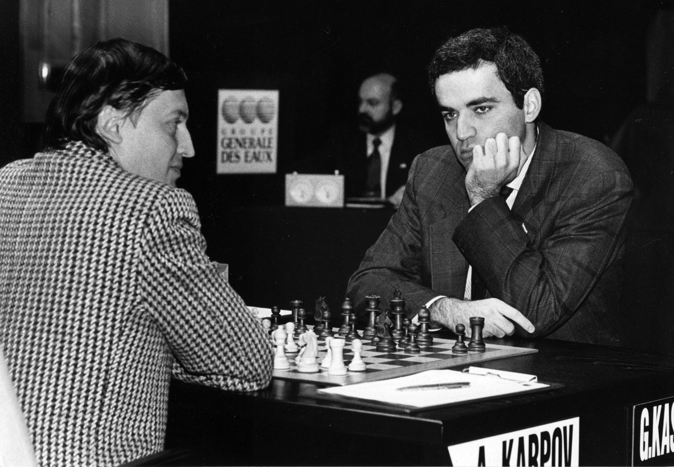

Slide 2

The Machine Learning Process
using a decision tree model
Part 01
Reza Dibaj

Slide 3
Outline
What is Machine Learning? Difference between apple and orange
What is Classifier?
Supervised Learning Recipe
Collect Training Data
Train Classifier
Make Predictions

Slide 4
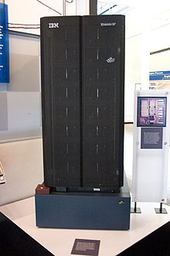
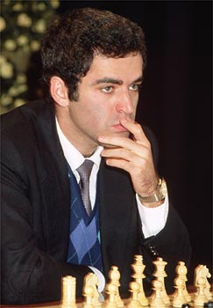
What is Machine Learning?
Subfield of Artificial Intelligence (AI)
Early AI programs typically excelled at one specific task
e.g. Deep Blue (chess computer)
VS
IBM Deep Blue
Garry Kasparov

Slide 5
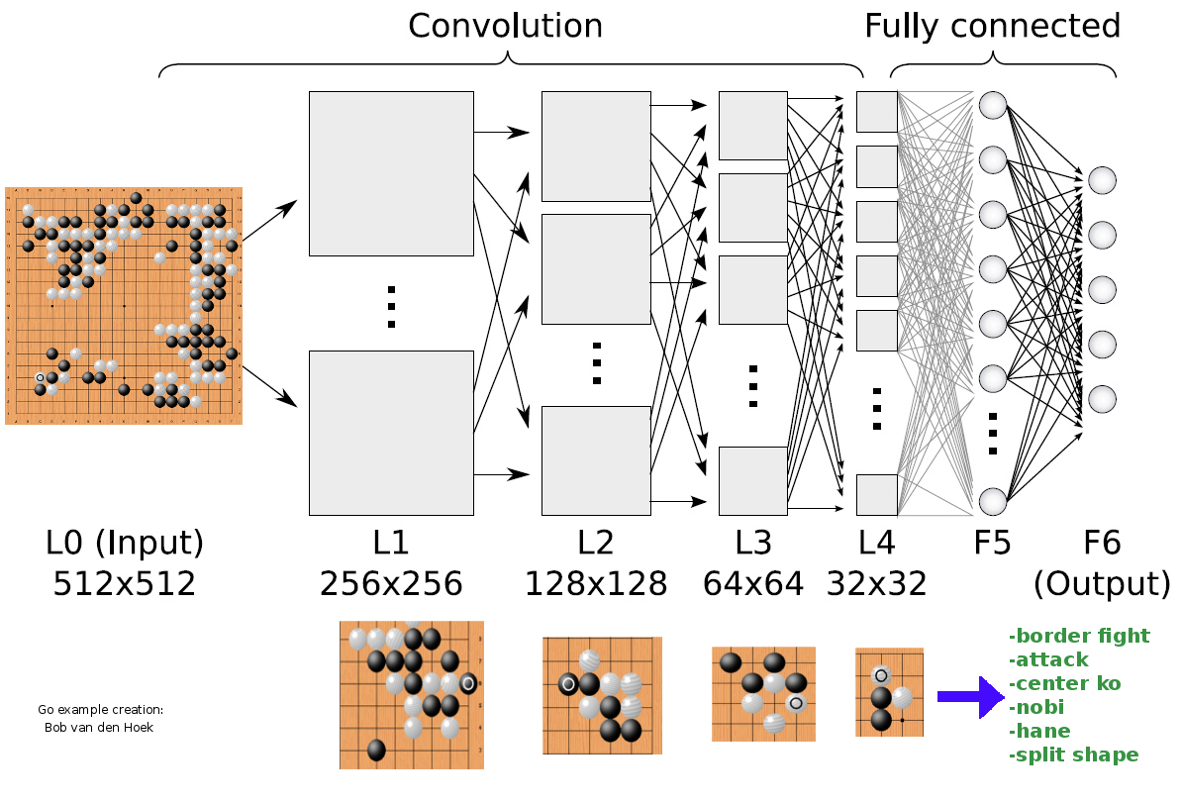
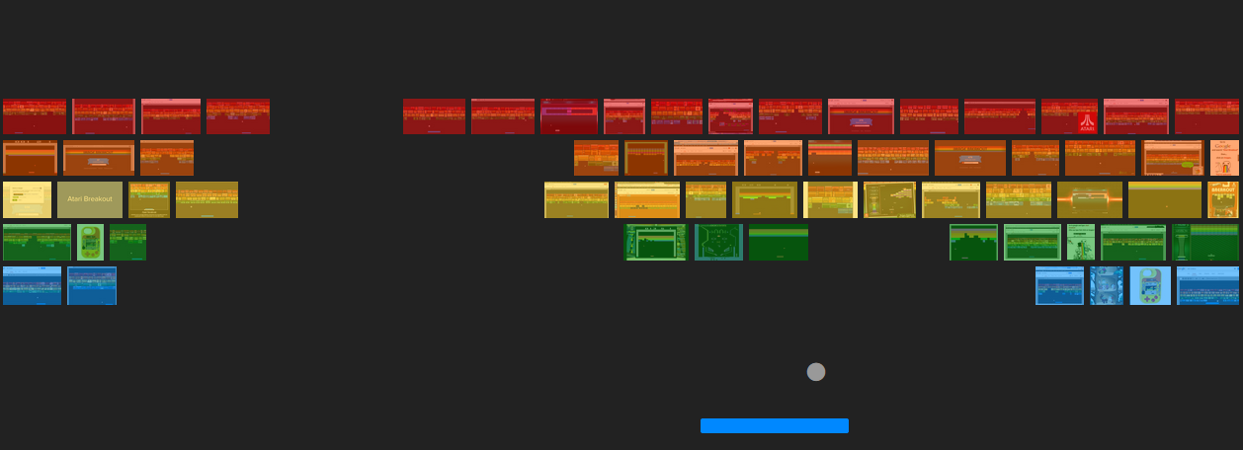

What is Machine Learning?
Writing one program that can solve a number of problems without needing to be rewritten
Notes:
We want to write one program that can solve many problems without needing to be rewritten

Slide 6

What is Machine Learning?
Machine Learning: algorithms that learn from examples and experience, instead of relying on hard-coded rules

Slide 7
What is Machine Learning?
Traditional Programming vs Machine Learning
Rules
Traditional
Programming
Answers
Data
Answers
Machine
Learning
Rules
Data

Slide 8
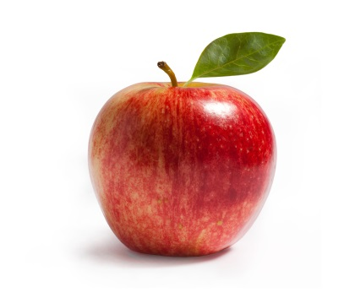

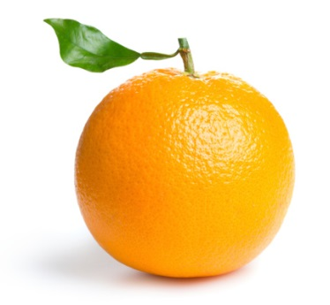
Difference between apple and orange
Write a program to take an image file as input, does some analyses, and output the type of fruit:
“Apple”
“Orange”

Slide 9

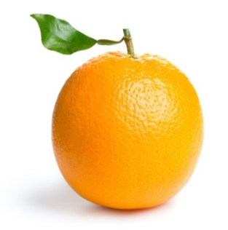
Difference between apple and orange
Counting the number of orange pixels and green pixels
Calculate the ratio
Notes:
Write a program to take an image file as an input, does some analyses, and output the type of the fruit:
Counting the number of orange pixels and green pixels
Calculate the ratio

Slide 10
Difference between apple and orange
Classical programming approach:
def detect_colors(image):
# lots of code
def detect_edges(image):
# lots of code
def analyse_shapes(image):
# lots of code
def guess_texture(image):
# lots of code
def define_fruit(image):
# lots of code
def handle_probability(image):
# lots of code

Slide 11
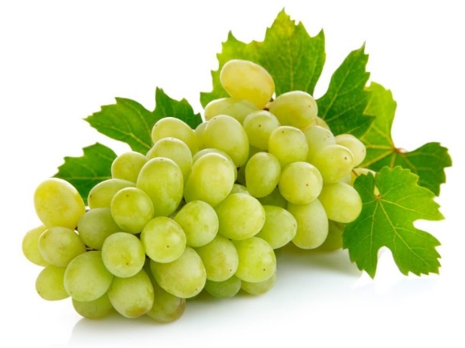
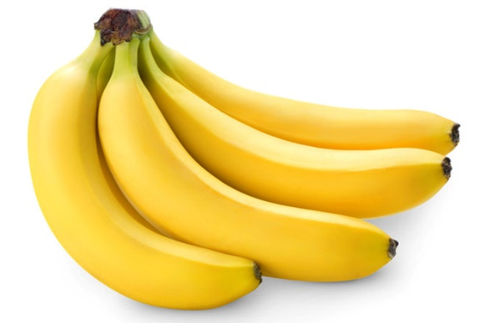
Difference between apple and orange
How about writing a program to handle black-and-white photo?
How about the images that contain other types of fruit?
?
?
Notes:
That works fine for simple images like these. But as you dive deeper into the problem, you will find the real world is messy, and the rules you write start to break.
How about writing a program to handle black-and-white photo?
How about the images that contains other types of fruits?

Slide 12

What is Classifier?
Machine Learning is all about the algorithms that can define these rules for us.
For that we are going to train a classifier.
f(x) = y
“Spam”
“Apple”
Features
Label
Notes:
Clearly we need something better. To solve this, we need an algorithm that can figure out the rules for us, so we do not have to write them by hand.
And for that we are going to train a classifier.
For now, you can think of a classifier as a function.
Classifier is similar to a function that takes some data as input and assigns label to it as output.

Slide 13
What is Classifier?
The technique to write the classifier automatically is called Supervised Learning.
It begins with examples of a problem you want to solve by finding patterns in these examples.

Slide 14
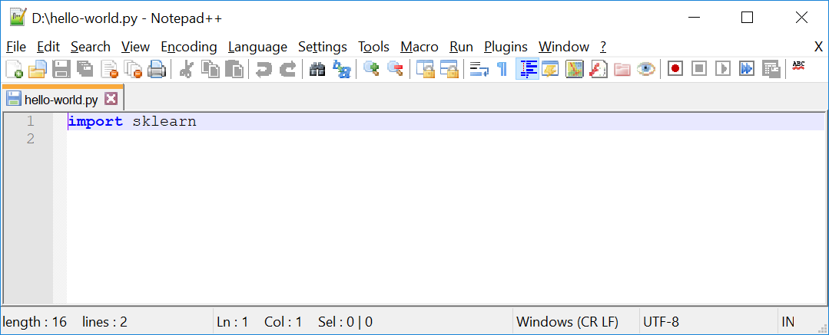
Supervised Learning Recipe
Now create a file, named hello-world.py as follows:
Notes:
Hello-world.py
import sklearn
Command line:
python hello-world.py

Slide 15
Supervised Learning Recipe
Collect Training Data
Training Classifier
Make Predictions

Slide 16
Supervised Learning Recipe
Collect Training Data
The more data we have, the better classifier we can make.
Features
Weight | Texture | Label
150g | Bumpy | Orange
170g | Bumpy | Orange
140g | Smooth | Apple
130g | Smooth | Apple
… | … | …
Examples
Notes:
Imagine we head out to an orchard.

Slide 17
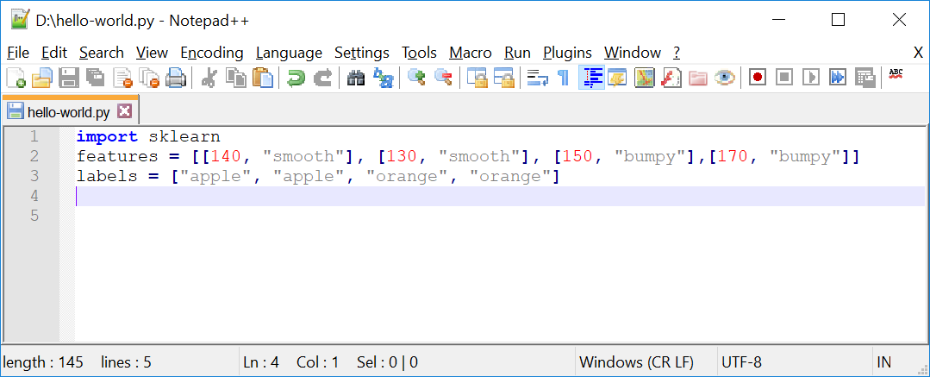
Supervised Learning Recipe
Collect Training Data
Let’s get back to our “hello-world.py” file:
Input
Output
Notes:
import sklearn
features = [[140, "smooth"], [130, "smooth"], [150, "bumpy"],[170, "bumpy"]]
labels = ["apple", "apple", "orange", "orange"]

Slide 18
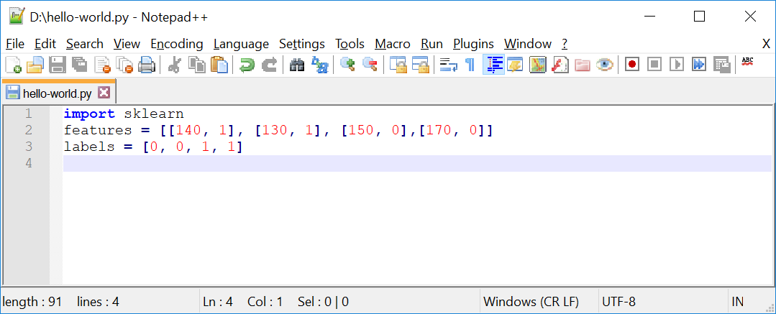
Supervised Learning Recipe
Collect Training Data
Replacing features and labels with integer values.
Input
Output
Notes:
import sklearn
features = [[140, 1], [130, 1], [150, 0],[170, 0]]
labels = [0, 0, 1, 1]

Slide 19
Supervised Learning Recipe
Training Classifier
Training classifier using a decision tree model:
Collect Training Data
Training Classifier
Make Predictions

Slide 20
Supervised Learning Recipe
Training Classifier
We use Decision Tree as our classifier and let’s assume it as a box of rules for now.
Weight > 150g?
Yes
No
Texture = bumpy?
Yes
No
Orange
Apple

Slide 21
Supervised Learning Recipe
Training Classifier
We have different classifiers, and decision tree is one of them.
160g Bumpy
“Orange”
Notes:
Different classifiers:
Linear Classifiers: Logistic Regression, Naive Bayes Classifier
Support Vector Machines (SVM)
Decision Trees
Boosted Trees
Random Forest
Artificial Neural Networks (ANN)
Nearest Neighbor

Slide 22
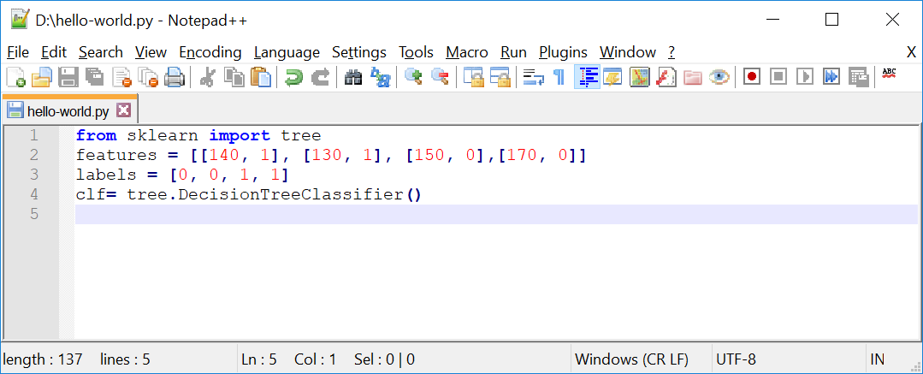
Supervised Learning Recipe
Training Classifier
At this point we define a classifier which is a box of rules. It does not know anything about “apple” and “orange” yet. To train it we need a learning algorithm.
Notes:
from sklearn import tree
features = [[140, 1], [130, 1], [150, 0],[170, 0]]
labels = [0, 0, 1, 1]
clf= tree.DecisionTreeClassifier()

Slide 23



Supervised Learning Recipe
Training Classifier
If we consider a classifier as a box of rules, then we can assume a learning algorithm as the procedure that creates those rules. It does that by finding patterns in our training data.

Slide 24
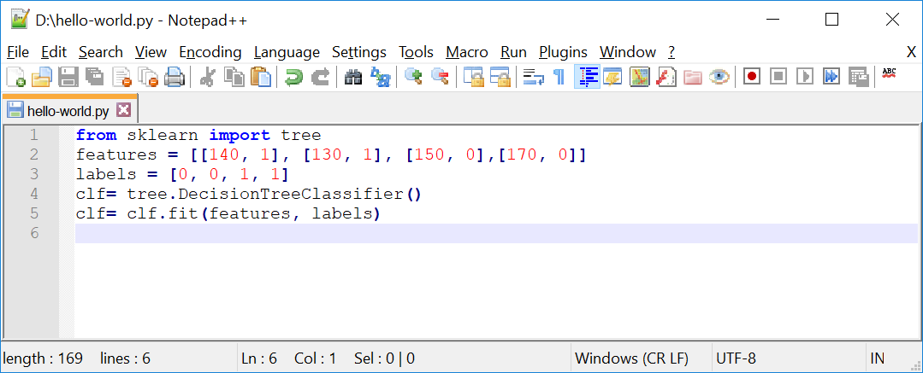
Supervised Learning Recipe
Training Classifier
In scikit the training algorithm is included in the classifier object and is called fit, which is finding patterns in data.
Notes:
Important: We can think of fit as find patterns in data.
We will get into details of how this happens under the hood in a future presentation.
from sklearn import tree
features = [[140, 1], [130, 1], [150, 0],[170, 0]]
labels = [0, 0, 1, 1]
clf= tree.DecisionTreeClassifier()
clf= clf.fit(features, labels)

Slide 25
Supervised Learning Recipe
Make Predictions
Collect Training Data
Training Classifier
Make Predictions

Slide 26
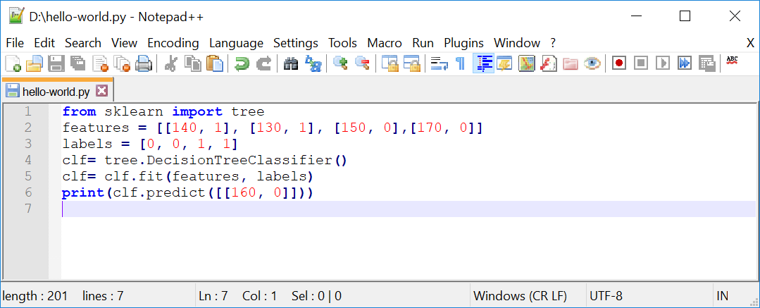
Supervised Learning Recipe
Make Predictions
Now its time to make a prediction. So let’s take it for a spin and use it to classify a new fruit. What is your guess in this example?
Notes:
from sklearn import tree
features = [[140, 1], [130, 1], [150, 0],[170, 0]]
labels = [0, 0, 1, 1]
clf= tree.DecisionTreeClassifier()
clf= clf.fit(features, labels)
print(clf.predict([[160, 0]]))

Slide 27
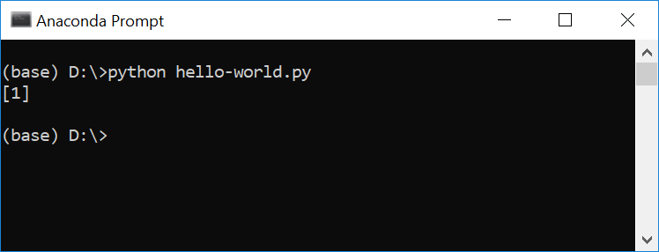
Supervised Learning Recipe
Make Predictions
That is true, as it is bumpy and heavier, it should be orange or 1.

Slide 28
Supervised Learning Recipe
Using the same program for a new problem
Defining a new classifier for a new problem, by changing the training data
Far more reusable than writing new rules for each problem
The more data we have, the better classifier we can make
Horsepower | Seat | Label
300 | 2 | sport-car
450 | 2 | sport-car
200 | 8 | minivan
150 | 9 | minivan
… | … | …
Notes:
This makes this approach far more reusable than writing new rules for each problem.

Slide 29




Supervised Learning Recipe
We can create a new classifier for a new problem, just by changing the training data.
This approach is far more reusable than writing new rules for each problem.
Question:
Could we use images instead of variables?
Image | Label
 | Orange
 | Orange
 | Apple
 | Apple

Slide 30
Important Concepts
How does this work in the real world?
How much training data do we need?
How is the tree created?
What makes a good feature?

Slide 31

Thank you
Question?
To be
Not to be

